Slide 1
What is Natural Language Processing?
Anupam Guha

Slide 2
Pending topics in Python

Slide 3
Data, loops and functions
More on lists, set, tuple, dict
for, with list, range etc, loop in a list itself
while, types of while
break and continue
A basic function
iteration and recursion

Slide 4
Installing pip
Download get-pip.py from https://www.geeksforgeeks.org/how-to-install-pip-on-windows/
Go to python directory
> python get-pip.py
> pip –V
pip install make

Slide 5
Use pip to install the basics
>pip install –upgrade pip
>pip install numpy
>pip install scipy
>pip install matplotlib
>pip install -U scikit-learn
>pip install --user -U nltk

Slide 6
Simple NLP
Classification
Segmentation
Tokenisation
Tagging
Entity detection
Relation detection

Slide 7
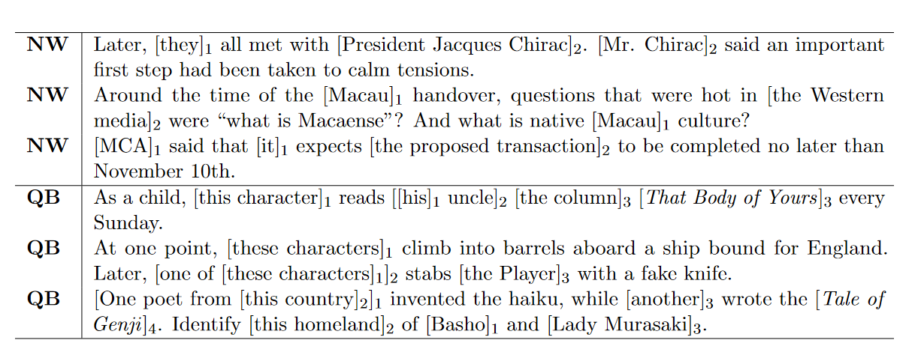
Coreference Resolution
Guha et al 2015

Slide 8
Stanford CoreNLP demo https://corenlp.run/

Slide 9
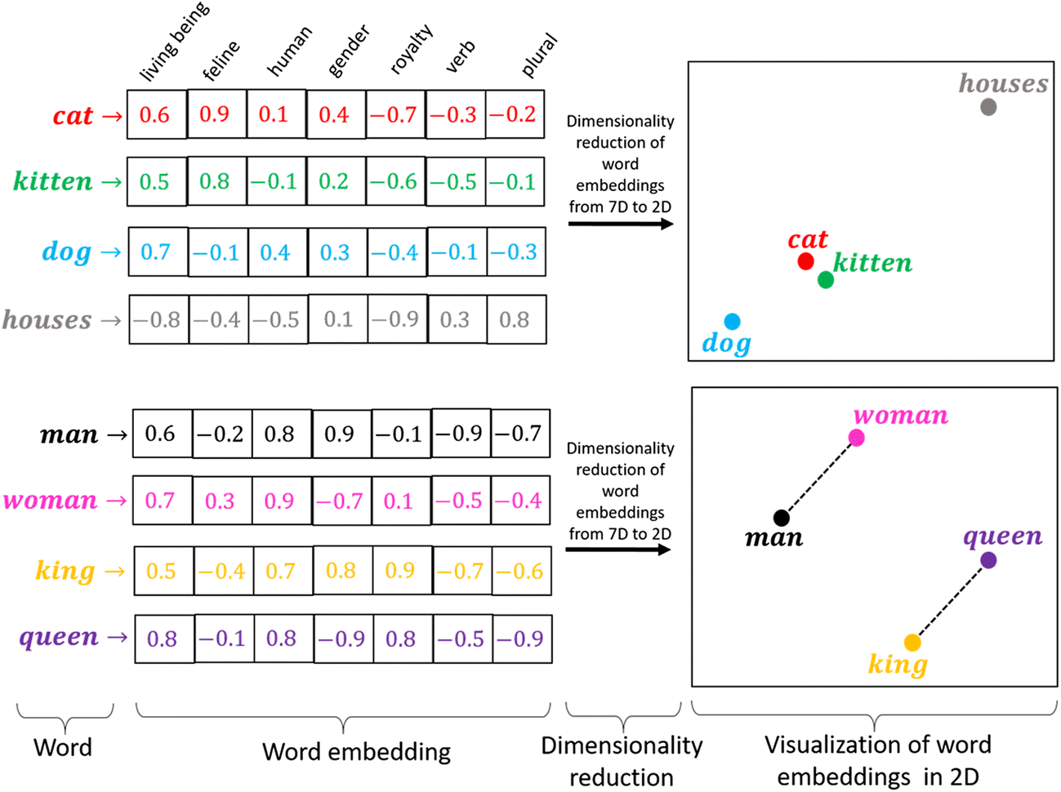
Word embeddings

Slide 10
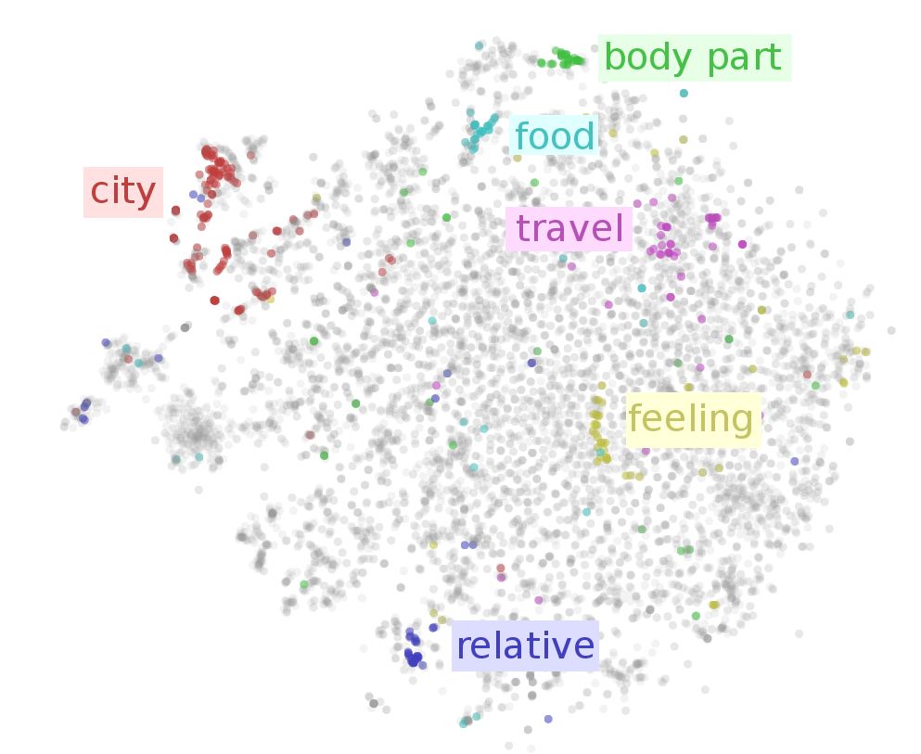

Slide 11
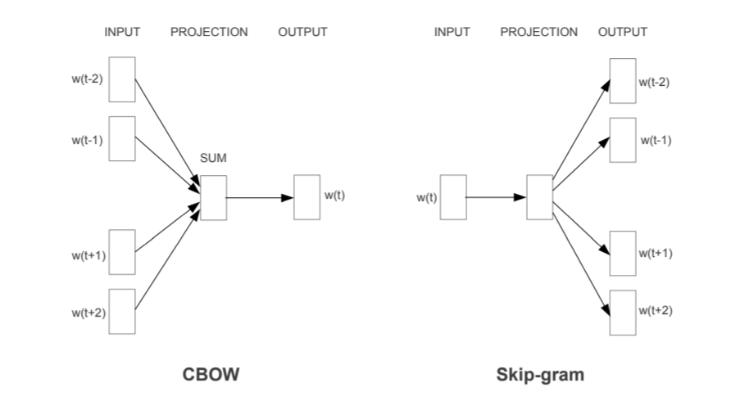

Slide 12
Topic Modelling
Topics
(word clouds)
Documents of a corpus
Topic modelling
Words/sentences/documents by topic distributions

Slide 13
NLTK basics
>>>import nltk
>>>nltk.download()
>>> from nltk.book import *
>>> text1
>>> text2
>>> text1.concordance(“stories")
>>> text1.similar(“stories")
>>> text2.similar("monstrous")

Slide 14
NLTK basics
>>> text4.dispersion_plot(["citizens", "democracy", "freedom", "duties", "America"])
>>> len(text4)
>>> sorted(set(text1))
>>> len(set(text3))
>>> len(set(text3)) / len(text3)
>>> def lexical_diversity(text):
… return len(set(text)) / len(text)

Slide 15
NLTK basics
>>> def percentage(count, total):
… return 100 * count / total
>>> sent1
>>> len(sent1)
>>> sent2 + sent3
Using append
Using index
Using ranges

Slide 16
Colocations and Bigrams
>>> list(bigrams(['more', 'is', 'said', 'than', 'done’]))
>>> text4.collocations()
>>> fdist1 = FreqDist(text1)
>>> fdist1.most_common(50)
>>> fdist1['whale’]
A small test, try to make a function which finds bigrams

Slide 17
Chapter 1 to 6 of the NLTK book https://www.nltk.org/book/

Slide 18
Resources
https://code.google.com/archive/p/word2vec/
https://drive.google.com/file/d/0B7XkCwpI5KDYNlNUTTlSS21pQmM
https://nlp.stanford.edu/projects/glove/
https://mccormickml.com/2019/05/14/BERT-word-embeddings-tutorial/#what-is-bert

Slide 19
Word embeddings demo

Slide 20
Discussion

